Slide 1
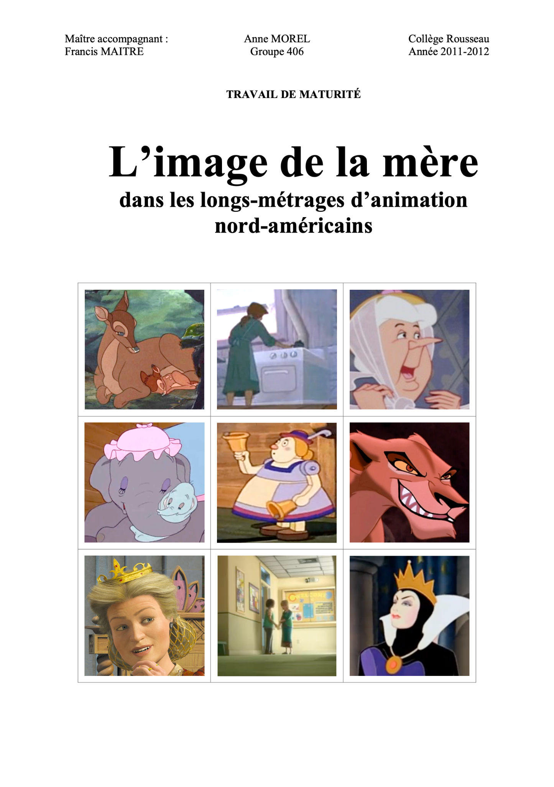
Do “good” mothers stay at home?
A study of the portrayal of mother figures in US animated movies
Patricio Becerra, Anne Morel
CAS Applied Data Science 2023, Module 2
based on the dataset of the Maturité work of Anne Morel (unpublished, 2012)
Notes:
Both

Slide 2
Mother figures in animation
Animated movies, like modern fairy tales, can be seen as tools that portray our vision of the world. They can therefore also transmit ideologies.
Mother figures in these movies are diverse, but do their characteristics follow the progression of society ?
Is a comforting or reassuring mother figure more often portrayed as spending more time at home? And is a threatening mother figure more often portrayed working full time ?
Do these portrayal tendencies change through time ?
Do they depend on whether the story is original (i.e., most likely recent) or based on an existing tale (i.e., most likely old) ?
Notes:
Anne

Slide 3
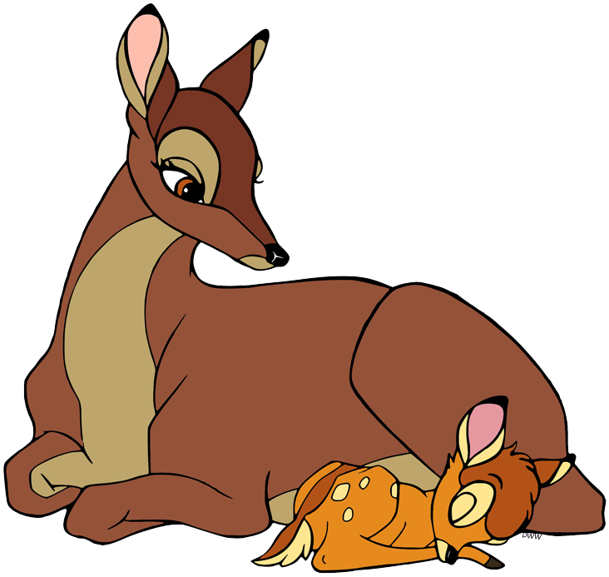
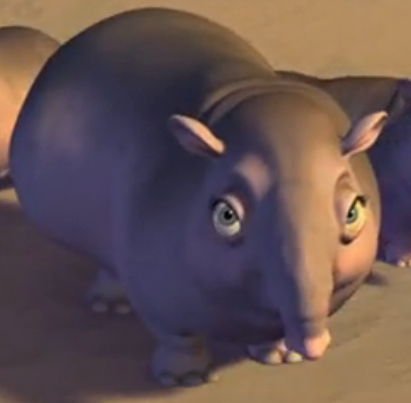
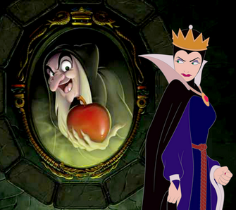
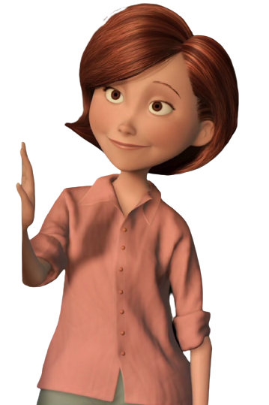
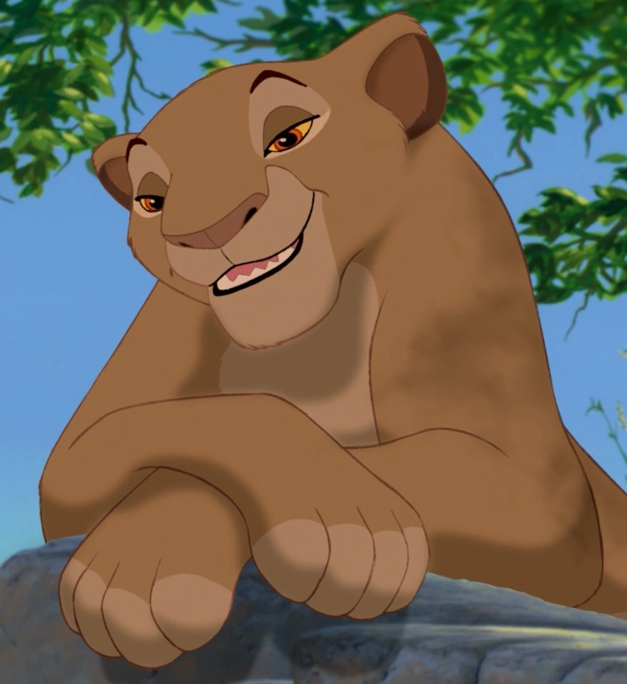
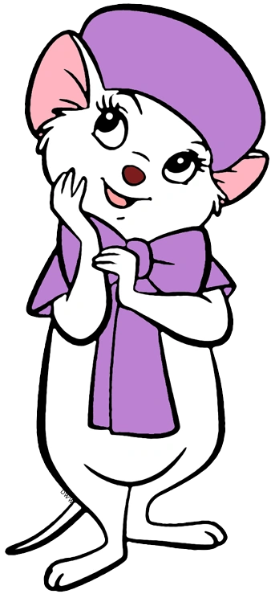

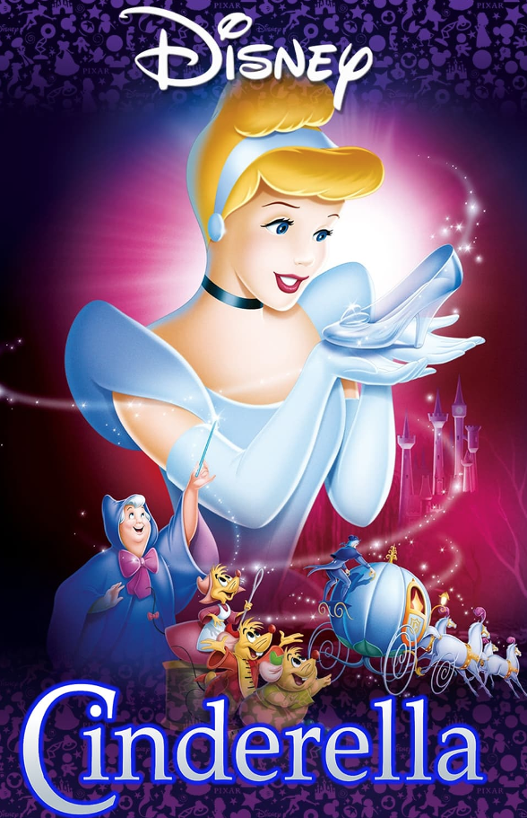
Dataset
Variables
Psychological (comforting, neutral, threatening)
Professional (stay-at-home, part-time work, full-time work)
Features
Year of release (1937 - 2011), Story Type (Original, Existing)
Data
624 mother figures
116 movies (e.g. Disney, Pixar, Dreamworks, etc.)
Notes:
Anne : there are more mother figures than what we expect, in the background

Slide 4
Objectives
Methods
Find whether there is a correlation between the Psychological and Professional variables.
Our hypothesis is therefore that there is a correlation, such that "At home" portrayals are more often also "comforting", and “Full-time work” portrayals are often also "threatening"
If the correlation is present, find whether this correlation changes:
2.1. Over time (by decade)
2.2. Depending on whether the story is original or from an existing tale.
Descriptive statistics to understand the data (measured by Anne during her Matura)
Chi-square test to find the correlation between categorical variables
→ Null hypothesis: There is no correlation between the “Psychological” and “Professional” variables
Notes:
Patricio

Slide 5
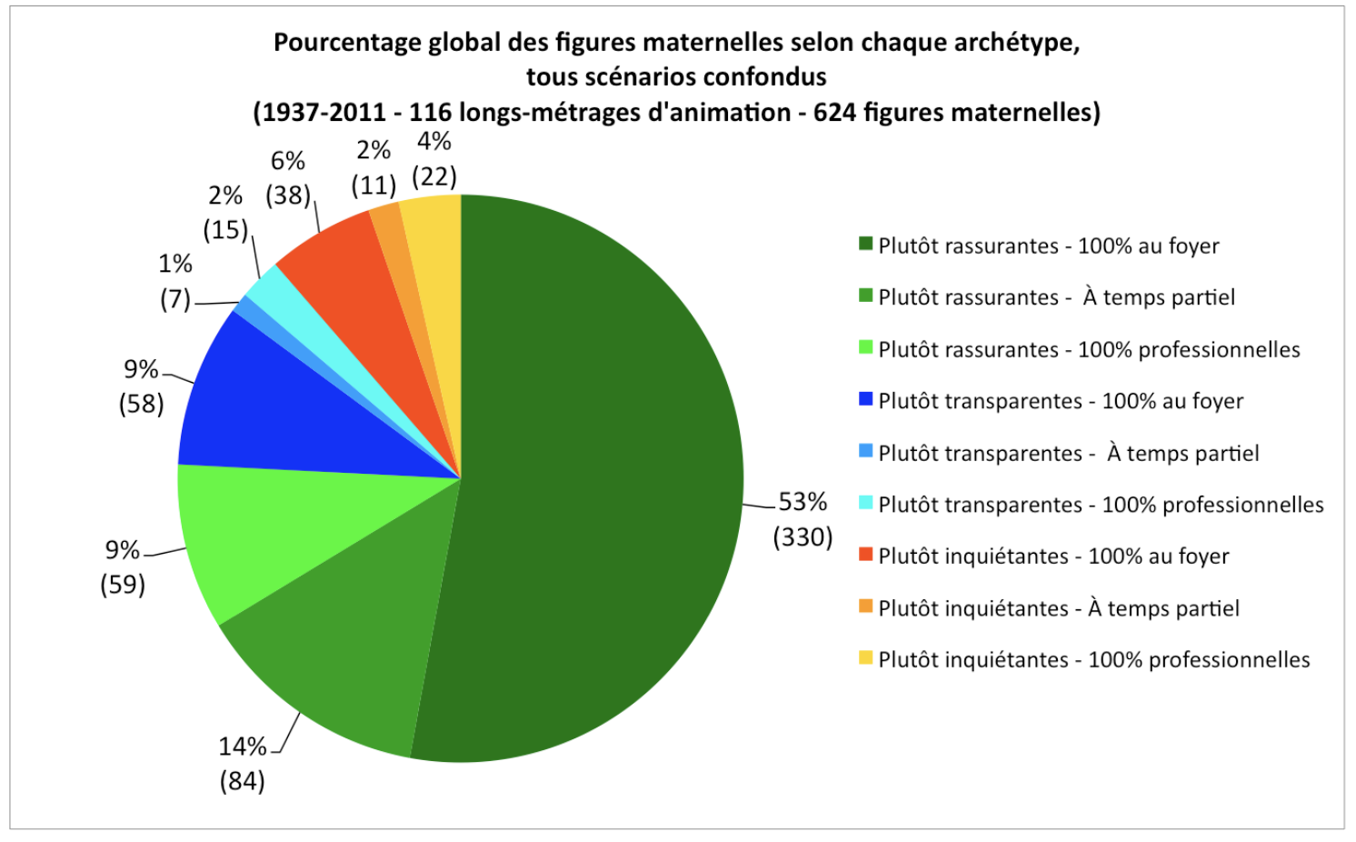
1. Overall: Descriptive statistics
Notes:
Anne

Slide 6
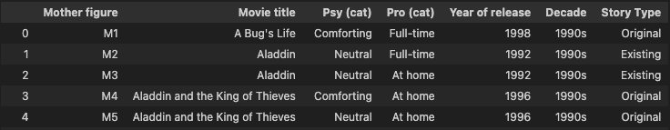
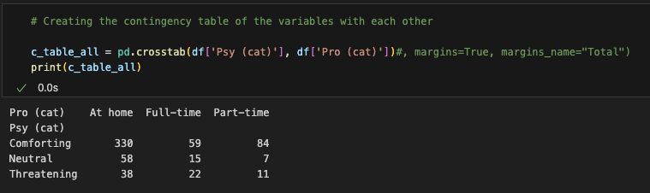
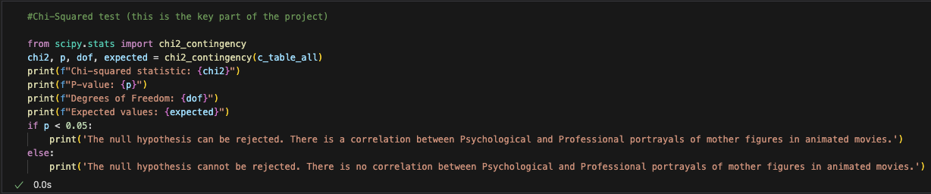
1. Overall: Python code flow
Import libraries
Read in the data with pandas
For the whole dataset (Objective 1):
Create a contingency table for each variable
Perform Chi-squared tests
Null hypothesis:
There is globally no correlation between both variable categories
Notes:
Patricio

Slide 7
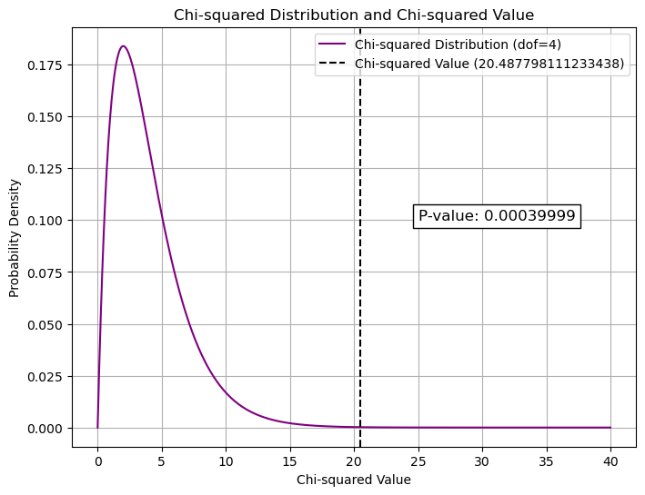
1. Overall: Chi-square test results
Chi-squared statistic: 20.487798111233438
P-value: 0.00039998905239838496
Degrees of Freedom: 4
Expected values: [[322.91346154 72.76923077 77.31730769] [ 54.61538462 12.30769231 13.07692308] [ 48.47115385 10.92307692 11.60576923]]
The null hypothesis can be rejected. There is a correlation between Psychological and Professional portrayals of mother figures in animated movies.
Notes:
Patricio

Slide 8
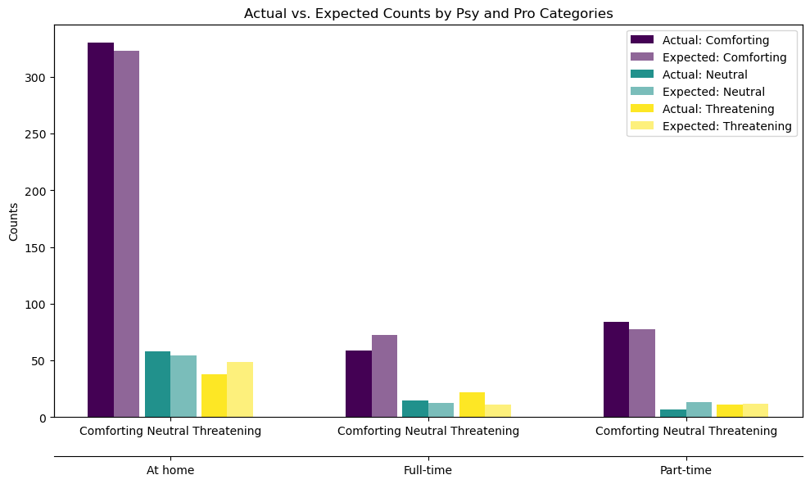
1. Overall: Observed vs. Chi-sq expected values
Pro (cat) At home Full-time Part-time
Psy (cat)
Comforting 322.913462 72.769231 77.317308
Neutral 54.615385 12.307692 13.076923
Threatening 48.471154 10.923077 11.605769
Pro (cat) At home Full-time Part-time
Psy (cat)
Comforting 330 59 84
Neutral 58 15 7
Threatening 38 22 11
Notes:
Patricio

Slide 9
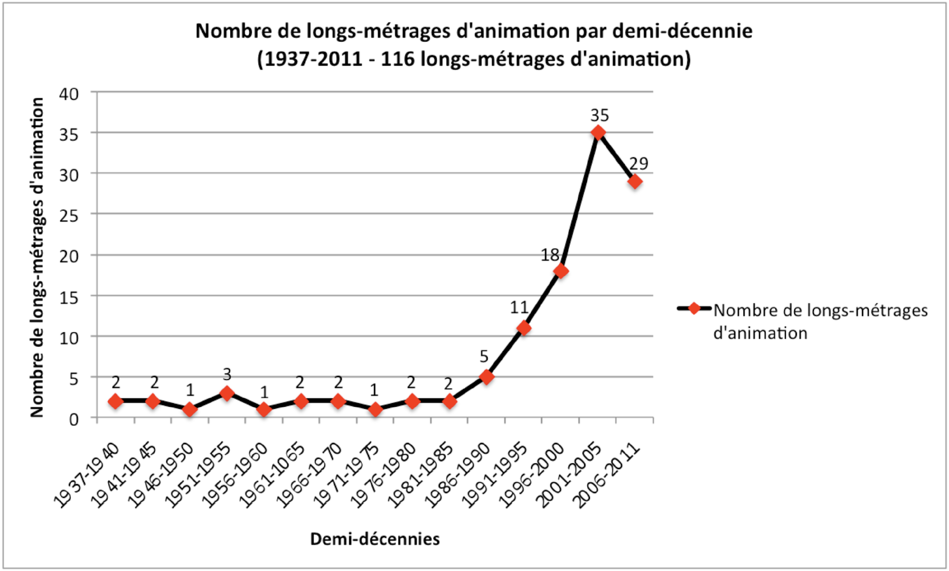
2.1 Decadal: Sample sizes
Notes:
Anne

Slide 10
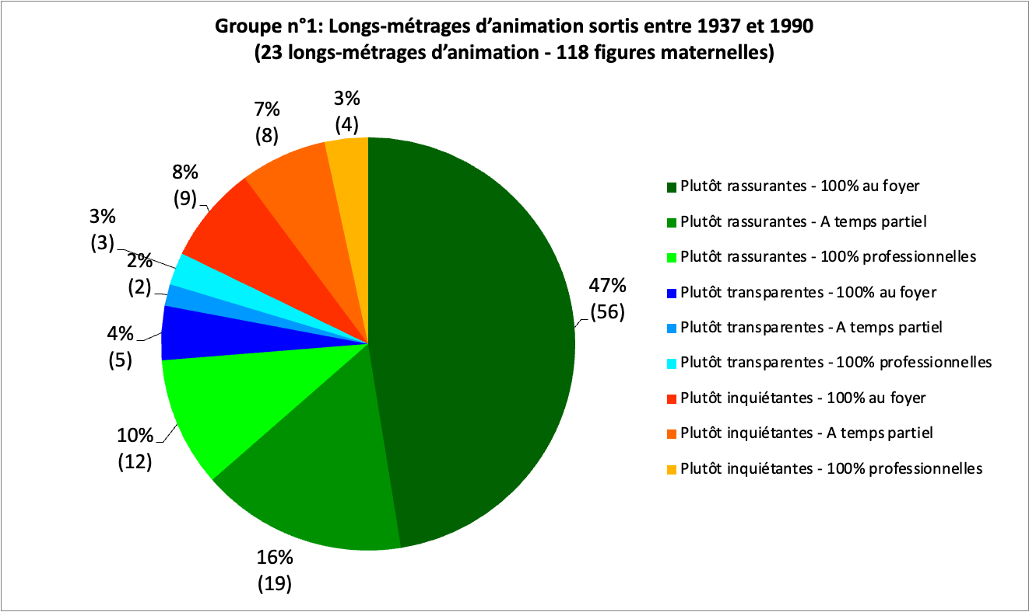
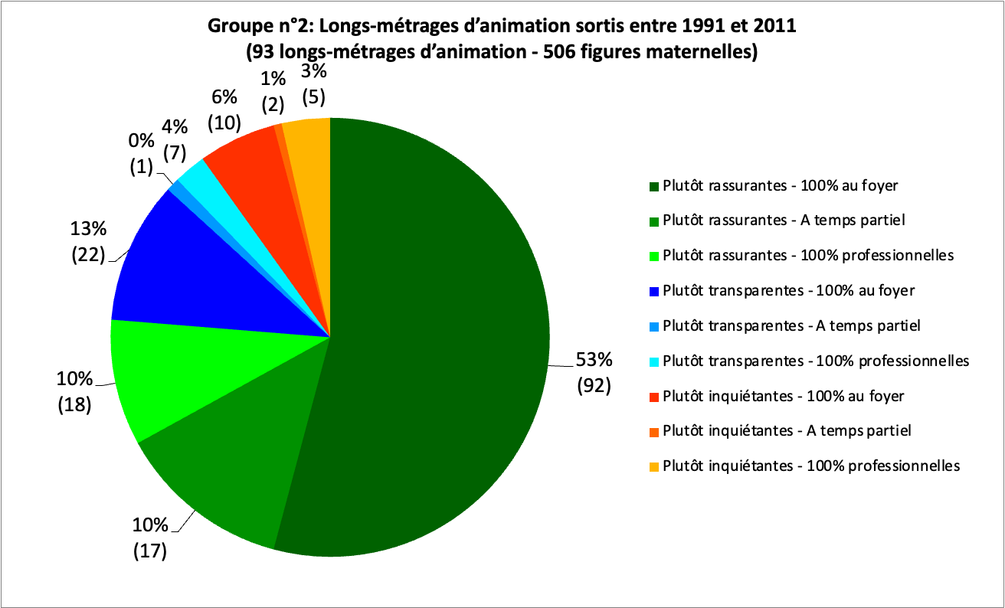
2.1 Decadal: descriptive statistics
Before 1990s
After 1990s
Notes:
Anne

Slide 11
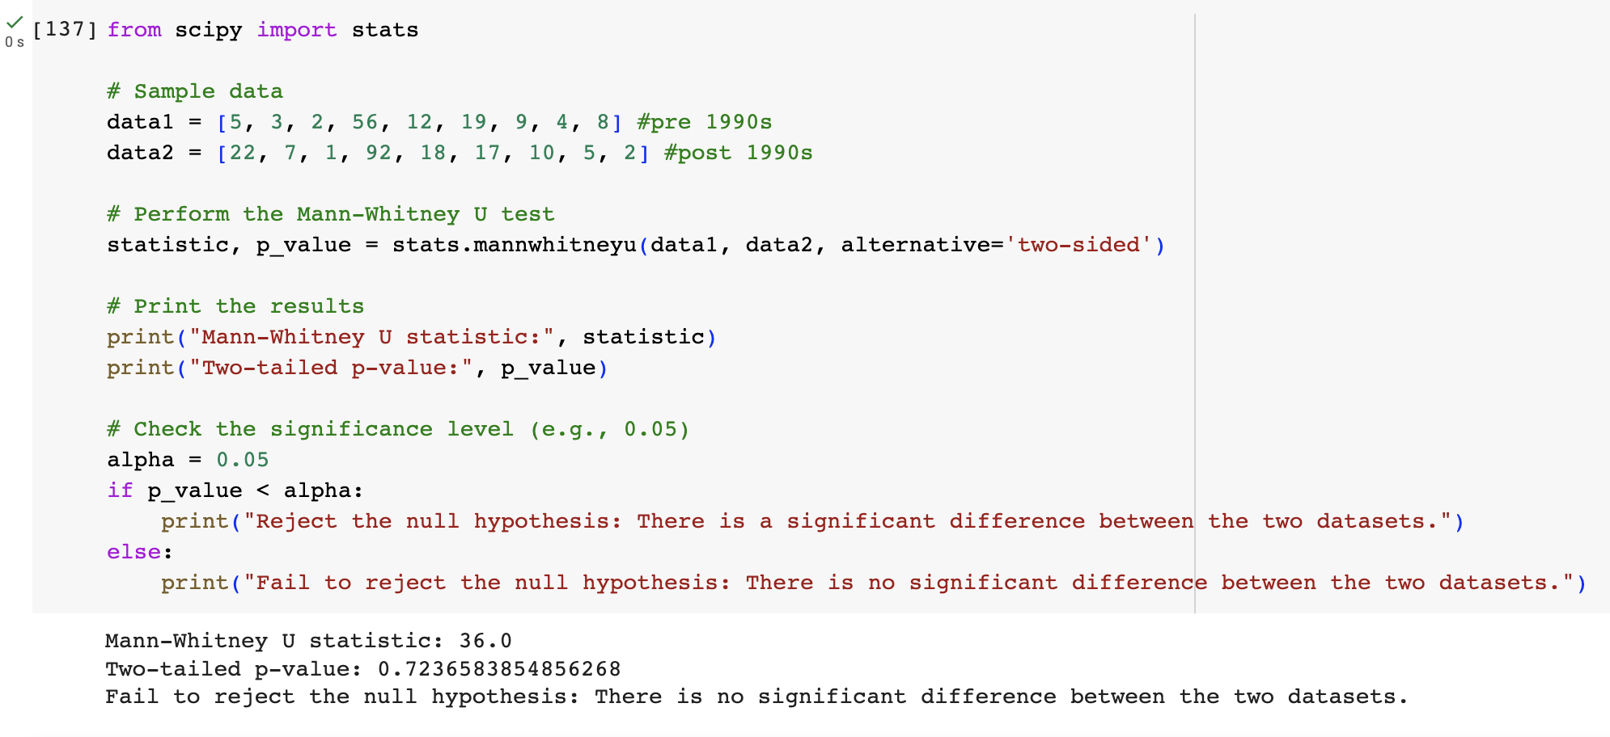
2.1 Decadal: Mann-Whitney U test
Notes:
Anne

Slide 12
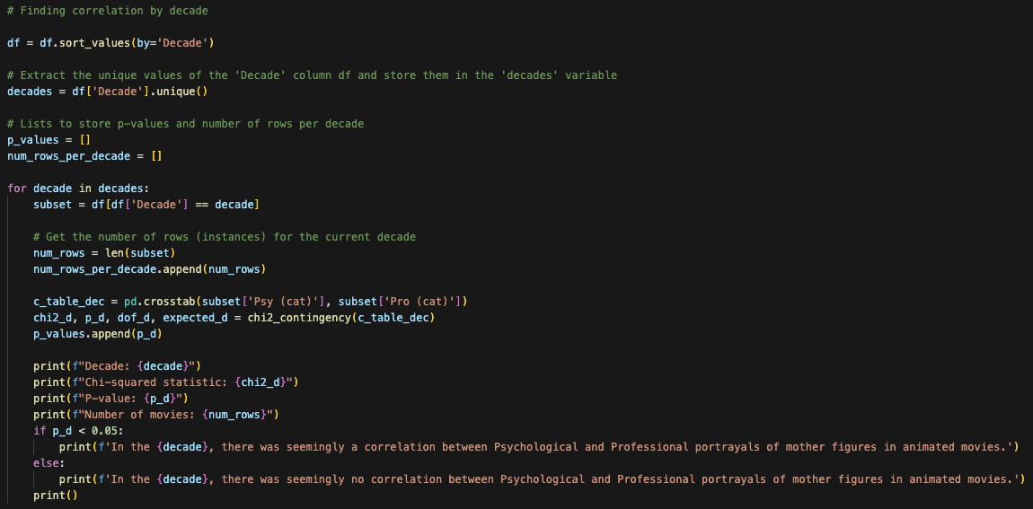
2.1 Decadal: Python code flow
Decadal (Objective 2.1):
Sort the data by decade
Loop through the decades:
Create contingency table
Perform Chi-squared test
Print result
Null hypotheses:
In each decade: There is no correlation between the variable categories
"Scientific" hypothesis:
The overall correlation observed changes across time
Notes:
Patricio

Slide 13
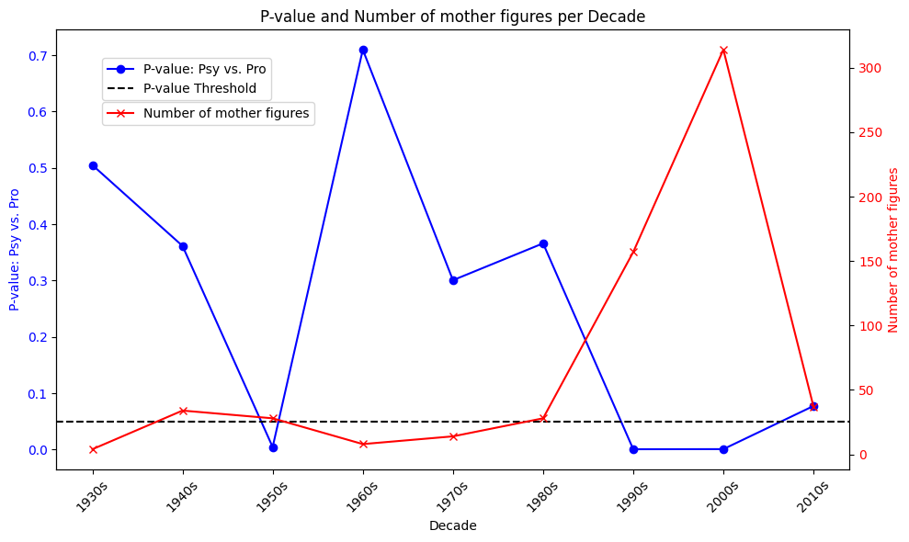
2.1 Decadal: Chi-square test results
Notes:
Patricio

Slide 14
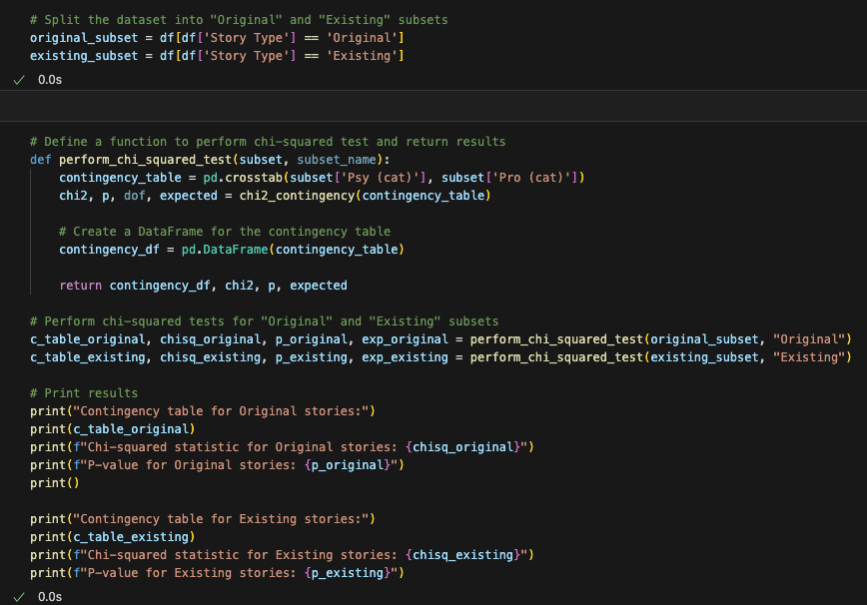
2.2 By Story Type: Python code flow
Story Type (Objective 2.2):
Split the data by story type
For each sub-dataframe:
Create contingency table
Perform Chi-squared test
Print result
Null hypotheses:
There is no correlation between the variable categories regardless of story type
"Scientific" hypothesis:
The overall correlation observed depends on the story type
Notes:
Patricio

Slide 15
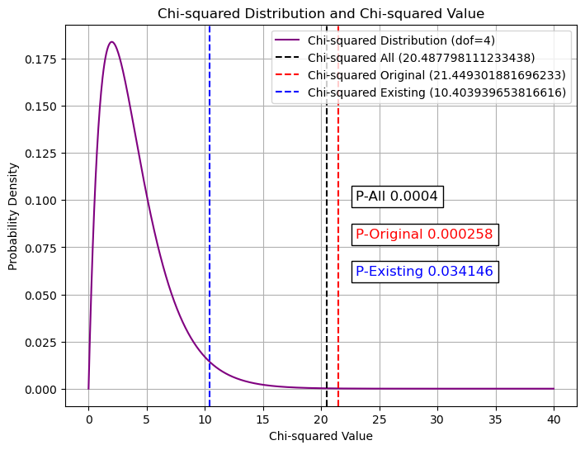
2.2 By Story Type: Chi-square test results
Contingency table for Original stories:
Pro (cat) At home Full-time Part-time
Psy (cat)
Comforting 188 31 48
Neutral 32 5 4
Threatening 20 13 1
Chi-squared statistic for Original stories: 21.449301881696233
P-value for Original stories: 0.0002578951638051745
Contingency table for Existing stories:
Pro (cat) At home Full-time Part-time
Psy (cat)
Comforting 142 28 36
Neutral 26 10 3
Threatening 18 9 10
Chi-squared statistic for Existing stories: 10.403939653816616
P-value for Existing stories: 0.03414623761713468
Notes:
Patricio

Slide 16
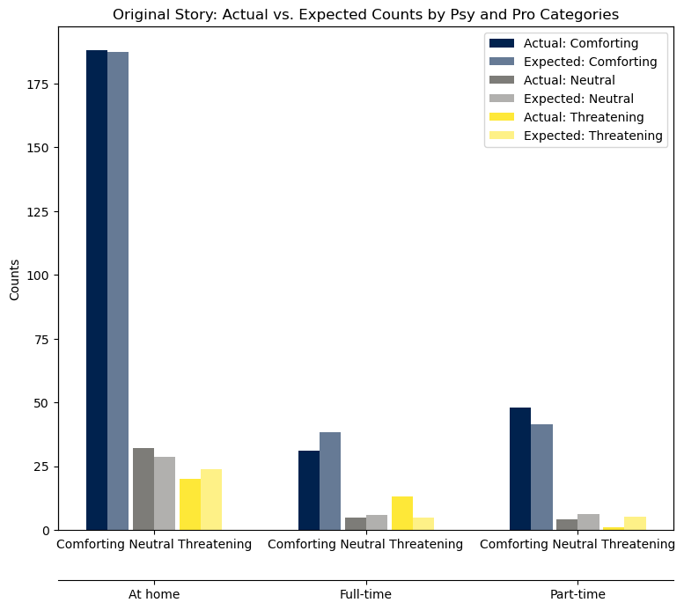
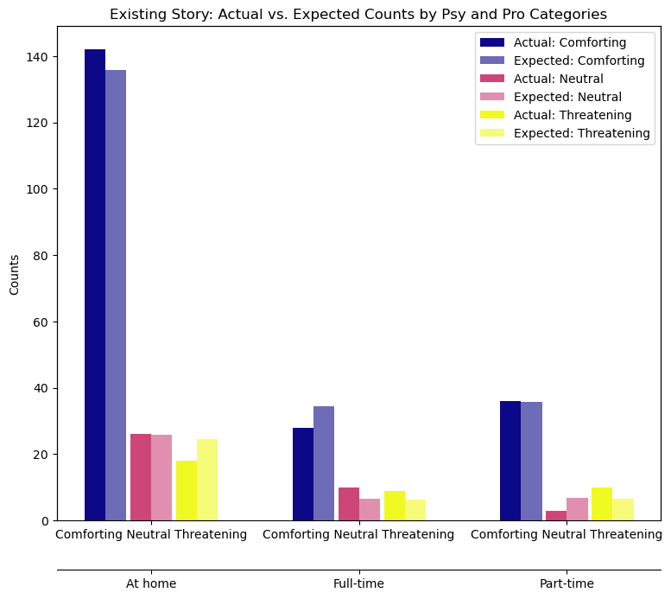
2.2 By Story Type: Observed vs. Chi-sq expected values
Notes:
Patricio

Slide 17
Conclusions
Potential further steps
Most portrayed mother figures are comforting, and most of those figures are stay-at-home mother figures → Over the entire dataset, there IS a correlation between the variables
A correlation between full-time working mother figures and threatening portrayals is not visible in the dataset
When split by decade, only the most recent movies display a correlation between the variables. However, there are much fewer movies made before 1990
When split by story type, the overall correlation is maintained with the same significance for original stories, but with much less significance for existing stories
Isolate the threatening data and perform another test to quantify the correlation level between the variables
Notes:
Anne

